Slide 1


Python + IOT
Course 2
Ver. 01
Copyright @ 2018 Innovaker

Slide 2

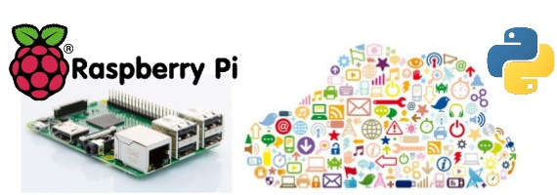
Course 1 Summary
Quick review of the Python programming
Introduction of Internet of things
2
Copyright @ 2018 Innovaker

Slide 3
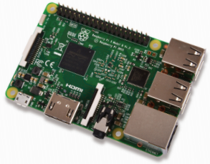
What is Raspberry Pi
The Raspberry Pi is a credit-card sized computer which can be used for many of the things that your desktop PC does, like wordprocessing and games.
Raspberry Pi is:
. low cost about $35
. credit card size
. run linux flavor OS / Raspbian
. support plenty of general purpose programming
. can support multiple interface
. can control external hardware through GPIO
3
Copyright @ 2018 Innovaker

Slide 4

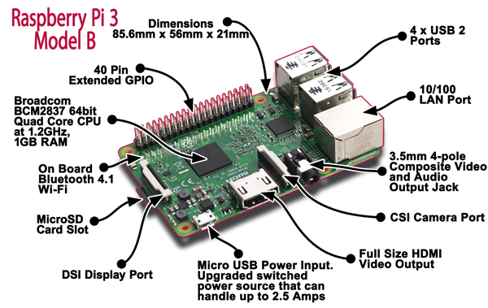
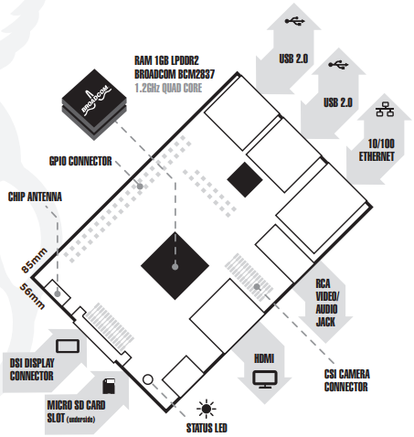
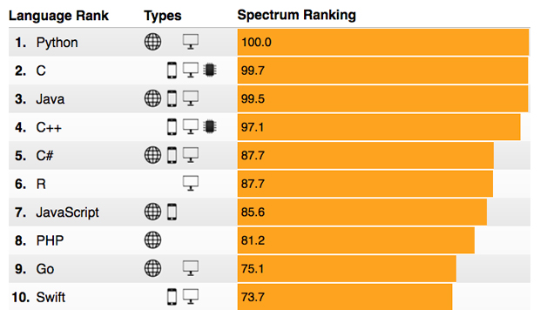
Raspberry Pi
Layout
Copyright @ 2018 Innovaker
Notes:
Here’s a simple list outlining whats on a Raspberry Pi 3
1 micro USB power port.
For power supply Pi uses a micro USB port and also for charging. A Micro USB power cord is needed for this. Cell phone chargers will work. You can also substitute with a kindle charger if you are short in supply of cell phone chargers. And one more thing- do not confuse mini USB from micro USB.
1 Ethernet LAN port. From above, this looks a looks a USB port-but this is the part that will connect to the internet. You do not need to configure anything but if you want wireless connection you will need to buy an extra wireless adapter.
1 micro SD card reader
For loading and installing operating system like linux OS. To load your desired Operating system, Raspberry Pi uses a micro SD card reader as a hard-drive. SD card is visible underneath the chip-just flip it over.
4 USB 2.0 ports
For connecting input devices and peripheral (like keyboards and mouse).
There are 4 USB ports here. You cant seen them here as they are bricked in pairs over the other. These ports are vital for connecting with your keyboards and other peripherals to make your Raspberry Pi work.
1 3.5mm jack
This offers both audio and composite video output (you do need to pair up with the right cable).
1 HDMI port
The HDMI port is used to connect to a monitor. Use a HDMI cable to make connection with the monitor. If you do no t have a HDMI cable then you can use a RCA cable. An RCA cable is a yellow video cable you see on your TV.
1.2 Ghz ARM processor Systems-On-a-Chip (SoC)
The processor is integrated with a 1GB RAM. The Raspberry Pi 3’s processor is more powerful than the previous versions.
1 Integrated Wi-Fi/Bluetooth radio antenna.
It took a while to identify this antenna. Its really small but effective.
1 GPIO (General Purpose Input/Output) interface. Now i need to elaborate what this GPIO really is. The GPIO as you can see has pins. They are used to have low-level hardware access directly to the Pi board for attaching other hardware boards, peripherals, LCD display screens, and any other hardware devices to your Pi.

Slide 5
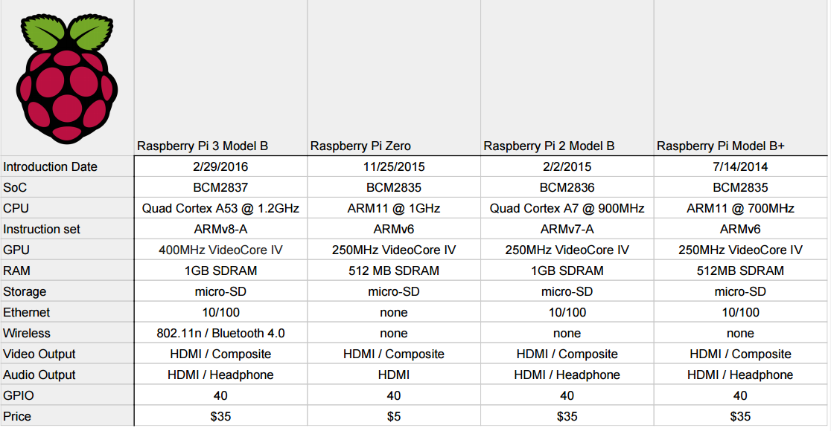
Raspberry Pi
Specification
Processor
Broadcom BCM2387 chipset.
1.2GHz Quad-Core ARM Cortex-A53
802.11 b/g/n Wireless LAN and Bluetooth 4.1
(Bluetooth Classic and LE)
GPU
Dual Core VideoCore IV® Multimedia Co-Processor.
Provides Open GL ES 2.0, hardware-accelerated
OpenVG, and 1080p30 H.264 high-profile decode.
Capable of 1Gpixel/s, 1.5Gtexel/s or 24GFLOPs with
texture filtering and DMA infrastructure
Memory 1GB LPDDR2
Dimensions
85 x 56 x 17mm Power Micro USB socket 5V1, 2.5A
Copyright @ 2018 Innovaker
Notes:
Processor
Broadcom BCM2387 chipset.
1.2GHz Quad-Core ARM Cortex-A53
802.11 b/g/n Wireless LAN and Bluetooth 4.1
(Bluetooth Classic and LE)
GPU
Dual Core VideoCore IV® Multimedia Co-Processor.
Provides Open GL ES 2.0, hardware-accelerated
OpenVG, and 1080p30 H.264 high-profile decode.
Capable of 1Gpixel/s, 1.5Gtexel/s or 24GFLOPs with
texture filtering and DMA infrastructure
Memory 1GB LPDDR2
Dimensions
85 x 56 x 17mm Power Micro USB socket 5V1, 2.5A

Slide 6
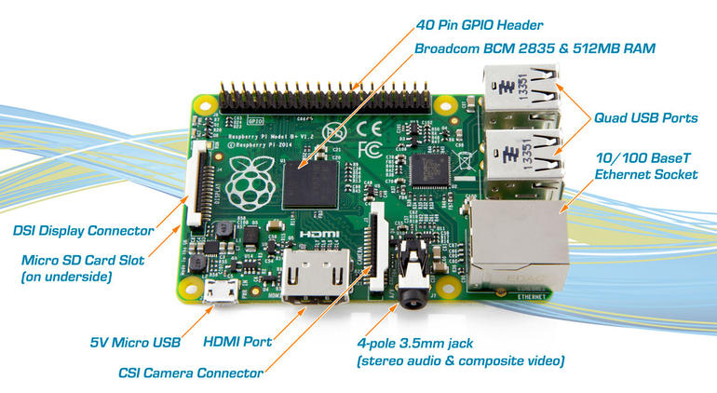
Raspberry Pi
connection
Ethernet 10/100
BaseT Ethernet socket
Video Output HDMI (rev 1.3 & 1.4
Composite RCA (PAL and NTSC)
Audio Output Audio Output 3.5mm jack,
HDMI USB 4 x USB 2.0 Connector
GPIO Connector 40-pin 2.54 mm (100 mil) expansion
header: 2x20 strip Providing 27 GPIO pins
plus +3.3 V, +5 V and GND supply lines
Camera Connector
15-pin MIPI Camera Serial Interface (CSI-2)
Display Connector DSI 15 way flat flex cable connector
with two data lanes and a clock lane
Memory Card Slot Push/pull Micro SDIO
Copyright @ 2018 Innovaker
Notes:
Ethernet 10/100
BaseT Ethernet socket
Video Output HDMI (rev 1.3 & 1.4
Composite RCA (PAL and NTSC)
Audio Output Audio Output 3.5mm jack,
HDMI USB 4 x USB 2.0 Connector
GPIO Connector 40-pin 2.54 mm (100 mil) expansion
header: 2x20 strip Providing 27 GPIO pins
plus +3.3 V, +5 V and GND supply lines
Camera Connector
15-pin MIPI Camera Serial Interface (CSI-2)
Display Connector DSI 15 way flat flex cable connector
with two data lanes and a clock lane
Memory Card Slot Push/pull Micro SDIO

Slide 7
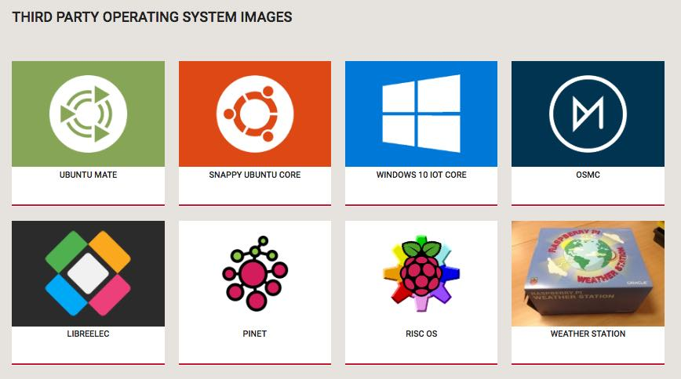
Raspberry Pi
Operating system
Boots from Micro SD card, running a version of the
. Linux operating system
or
. Windows 10 IoT
Copyright @ 2018 Innovaker
Notes:
Raspberry Pi is powered by ARM processor and your usual operating system images of Windows 10, Ubuntu Linux etc. can’t be installed on it.
Instead, you need to select an operating system that is supported by the Raspberry Pi’s ARM architecture. There are numerous supported operating systems like Raspbian, Arch Linux ARM, OpenWrt, Ubuntu MATE etc.
Instead of using a Raspbian OS image, here we’ll be using NOOBS–New Out Of Box Software–an install manager for Raspbian.
https://fossbytes.com/getting-started-raspberry-pi-installing-raspbian-os-noobs-boot/

Slide 8
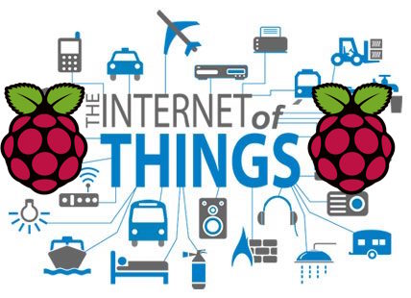
Raspberry Pi
Key applications
• Low cost PC/tablet/laptop • IoT applications
• Media center • Robotics
• Industrial/Home automation
• Server/cloud server
• Print server • Security monitoring
• Web camera • Gaming
• Wireless access point
• Environmental sensing/monitoring (e.g. weather station)
Copyright @ 2018 Innovaker
Notes:
• Low cost PC/tablet/laptop • IoT applications
• Media center • Robotics
• Industrial/Home automation
• Server/cloud server
• Print server • Security monitoring
• Web camera • Gaming
• Wireless access point
• Environmental sensing/monitoring (e.g. weather station)

Slide 9
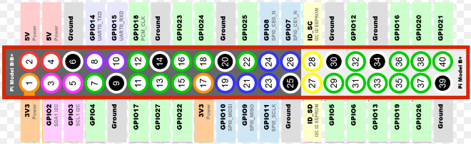
Raspberry Pi
GPIO I
layout
GPIO (general purpose input/output) pins are used to communicate with other circuitry such as extension boards, custom circuits and much more.
Copyright @ 2018 Innovaker
Notes:
GPIO pins can be configured as either general-purpose input, general-purpose output or as one of up to 6 special alternate settings, the functions of which are pin-dependent.
General-purpose input/output (GPIO) is a generic pin on an integrated circuit or computer board whose behavior—including whether it is an input or output pin—is controllable by the user at run time. GPIO pins have no predefined purpose, and go unused by default.

Slide 10
Raspberry Pi
Raspbian
installation
Raspbian is the desired operating system for the Raspberry Pi. In order to download and install the operating system onto our Raspberry Pi;
you will need the following:
◻ Raspbian (http://www.raspberrypi.org/downloads)
◻ Win32DiskImager (http://sourceforge.net/projects/win32diskimager)
◻ A USB memory card reader
Download both Raspbian and Win32DiskImagerPlug the USB memory card reader into your computer
Open Win32DiskImager
Find the location of the image file and the memory card
Click “Write” and wait for the write to complete
Exit the imager and eject the SD card
Copyright @ 2018 Innovaker

Slide 11
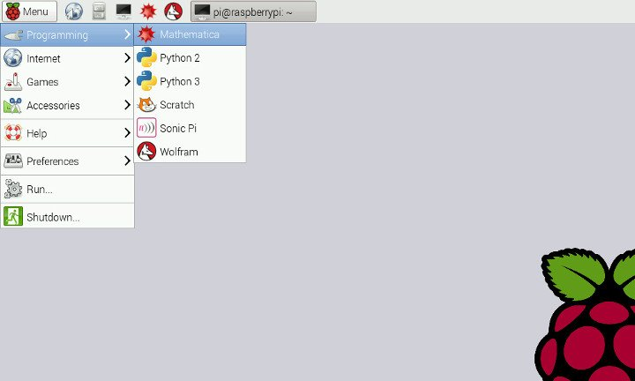
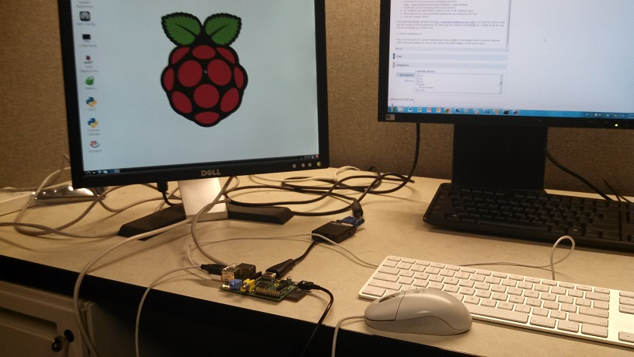
Raspberry Pi
Raspbian login
Hook monitor, mouse and keyboard to Pi, start Pi, see login screen
Username: pi Password: raspberry
Copyright @ 2018 Innovaker

Slide 12
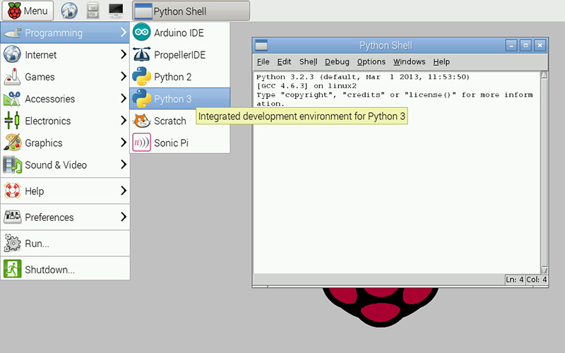
Raspberry Pi
Python
programming
Copyright @ 2018 Innovaker

Slide 13
Raspberry Pi
remote access
option 1 step 1
Install VNC
1 . On your laptop:
◼ Install VNC Viewer (Client)
http://www.realvnc.com/download/viewer/
Optional , install SSH (such as PUTTY on Windows)
https://www.chiark.greenend.org.uk/~sgtatham/putty/latest.html
2. On your Pi (Either by SSH, or directly):
◼ Install VNC server (preinstalled with kits microSD)
sudo apt-get update sudo apt-get install realvnc-vnc-server sudo apt-get install realvnc-vnc-viewer # this is optional
select Menu > Preferences > Raspberry Pi Configuration > Interfaces and make sure VNC is set to Enabled.
Copyright @ 2018 Innovaker
Notes:
The most standard way of connecting with our Raspberry Pi is using a monitor, keyboard, and mouse. Plug in a monitor through the Raspberry Pi’s HDMI port and the keyboard/mouse through the USB A ports. Upon supplying the Raspberry Pi with power, you will immediately see a user friendly interface. At this point, your Raspberry Pi will be able to do almost everything your personal computer can: access the Internet, create documents, play games, and more!
Set Wifi
Click on top-right icon, turn on wifi, select Wifi name and input password. The Pi is on wifi network.
After connection, click the icon again, then move cursor over the icon, the IP address will be displayed as example: 192.168.0.15, or restart Pi, the IP will be displayed on LCD. The IP can be used by other computer / laptop / ipad / phone through VNC.
VNC
Virtual Network Computing (VNC) is another method of remotely connecting with a device such as Raspberry Pi without monitor / keyboard / mouse. When connected with the Raspberry Pi, all mouse and keyboard events from the remotely connected device are transmitted to the Pi, and the graphical interface is updated accordingly.
SSH (option)
Secure Shell (SSH) is a secured network protocol that allows for a secure remote login from one computer to another without window user interface. We can use SSH to create tunnels between your personal computer and the Raspberry Pi, allowing us to operate the Raspberry Pi as a headless device. In order to utilize the device, users must be familiar with the terminal command line to execute commands.

Slide 14
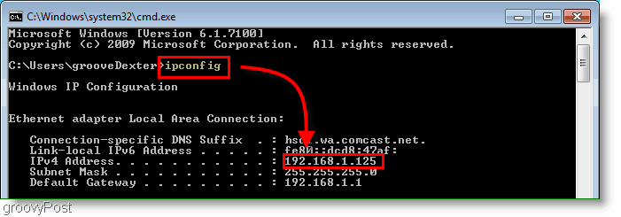
Raspberry Pi
remote access
option 1 step 2
find IP address
On your Pi （hook to monitor, and connect mouse / keyboard)
◼ start command line (tool), type ipconfig, find out the IP address
Copyright @ 2018 Innovaker
Notes:
Setup Connection:
Insert 16G Micro SD card into Raspberry Pi
Connect 40 pin cable as following picture, notice red line must be aligned as the picture and plug LCD on.
Connect Micro USB cable to the Pi and a 5V phone charger or a computer USB port.
After connect the power, after about 30 seconds, a beep sound, and LCD display IP address message.

Slide 15
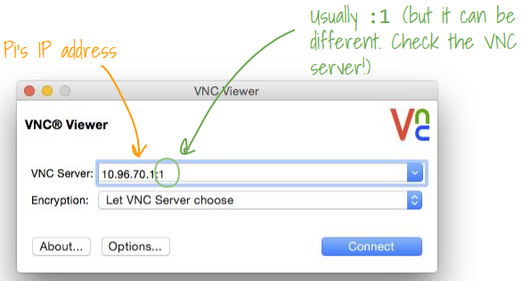
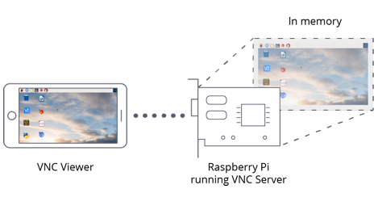
Raspberry Pi
remote access
option 1 step 3
remote login
On your laptop:
◼ start the VNC viewer, and enter the IP address
Copyright @ 2018 Innovaker
Notes:
SSH (option)
Secure Shell (SSH) is a secured network protocol that allows for a secure remote login from one computer to another without window user interface. We can use SSH to create tunnels between your personal computer and the Raspberry Pi, allowing us to operate the Raspberry Pi as a headless device. In order to utilize the device, users must be familiar with the terminal command line to execute commands.
Getting Set Up:
Windows:
Install PuTTY
MacOS or Linux:
Use the built-in ssh command to SSH into a device using the IP Address
ssh <username>@<ip-address>
Ex. ssh pi@193.24.1.15

Slide 16

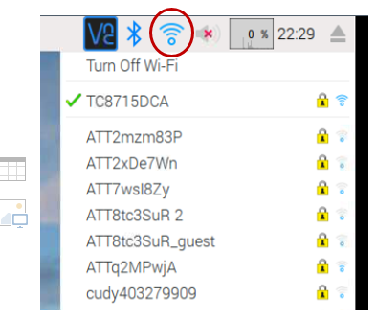
Raspberry Pi
remote access
option 1 step 4
final step
On your laptop:
◼ inside VNC viewer, see Pi screen remotely
Copyright @ 2018 Innovaker
Notes:
Get the IP address for Raspberry Pi can be tedious, especially when we try to connect to laptop, and without bother to hook on the
monitor, keyboard and mouse, the very basic information is the IP address (of Raspberry Pi after boot up) in LAN
With Innovaker Kits, besides this standard option, we have two more special designed option to easily get the IP address, which is quite handy.
Innovaker Kits special feature (not come with Raspbian)

Slide 17
What is Innovaker Digital Circuits Kits
Innovaker Digital Circuits Kit, is a special designed STEM kits. Using these tools from the kits, students can focus on electronic theory and programming instead of spending time making tedious wire connections. By undertaking a series of hands-on projects, students will learn how to develop rapid prototypes safely.
Innovaker Digital Circuits Kit includes:
. Pi PCB
. LED
. Resistor
. LCD
. Relay
. Buzzer
. Motion sensor
. Light sensor
. Button with cap
. 1uf Capacitor
. Temperature & Humidity Sensor
. Arduino Nano
17
Copyright @ 2018 Innovaker

Slide 18
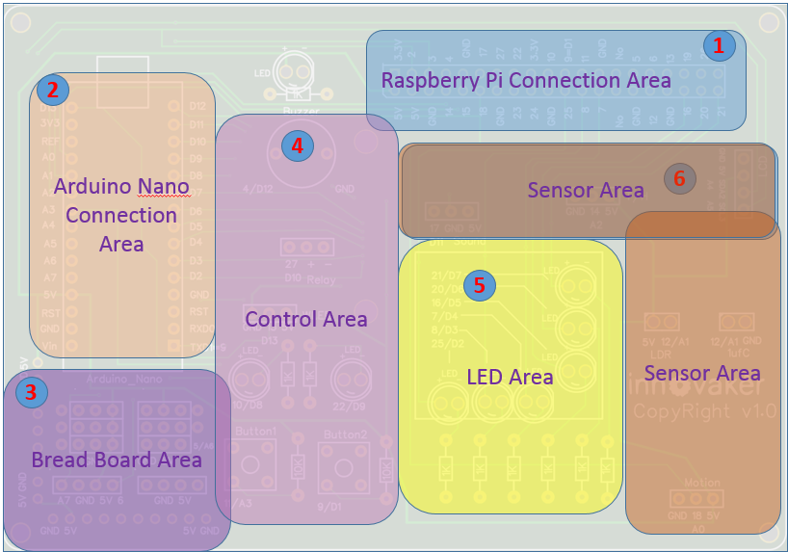
Innovaker Digital Circuits Kits layout
Innovaker Digital Circuits Kit, is a special designed STEM kits. It has built in Arduino Nano, and can connect to external Raspberry Pi.
18
Copyright @ 2018 Innovaker

Slide 19
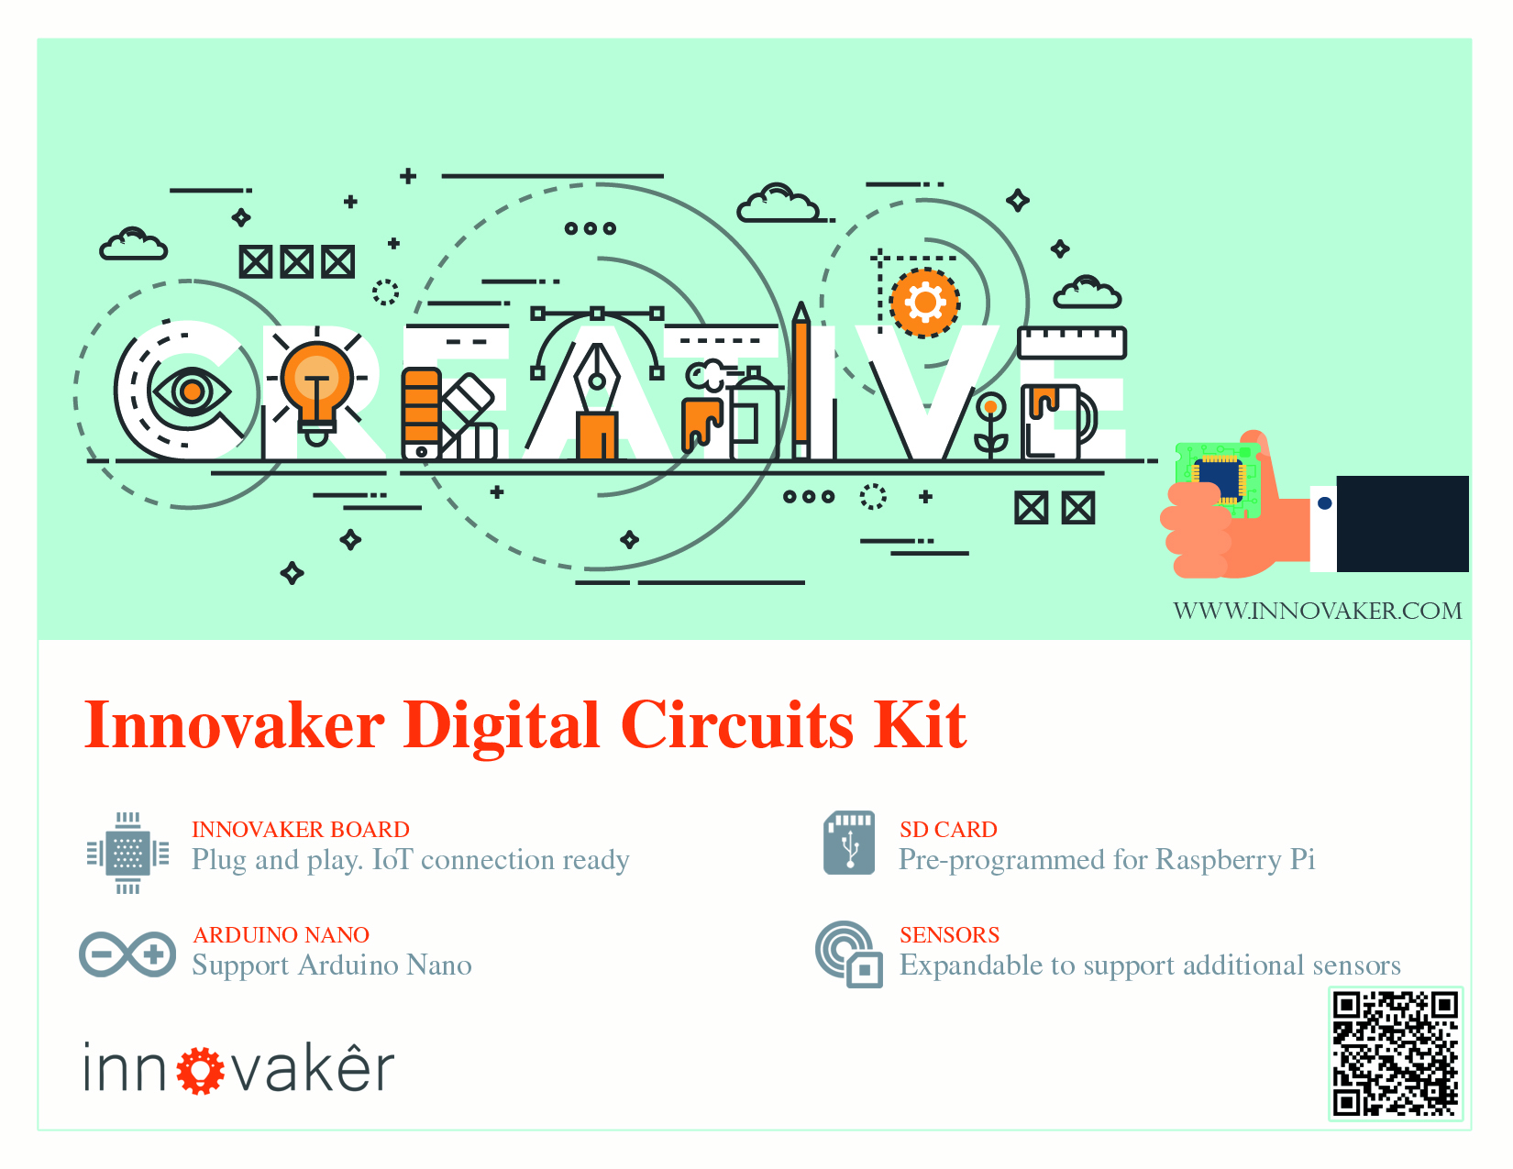
Innovaker Digital Circuits Kits key features
Innovaker Digital Circuits Kit, is a special designed STEM kits. It has built in Arduino Nano, and can connect to external Raspberry Pi.
19
Copyright @ 2018 Innovaker

Slide 20
Raspberry Pi
remote access
option 2
Use network cable to connect with router to get IP
Connect Pi with router with ethernet cable, start Pi, the IP will be displayed on LCD, then remote connect to Raspberry Pi through VNC viewer.
Option 1: use monitor / keyboard / mouse to connect to wifi (see previous slide)
Copyright @ 2018 Innovaker
Notes:
IP address
Get Pi IP address is one important step to use Pi with laptop or other computer.
If IP address for example as “192.168.0.15” is displayed on LCD, go to chapter VNC.
Here is workflow how to get wifi IP address:
If there is no IP address is displayed on LCD, there are three ways to get IP.
Use monitor / keyboard / mouse to connect to wifi
Use network cable to connect with router to get IP
Use smartphone hotspot to get IP
Following chapter will introduce above IP methods.
Innovaker Kits special feature (not come with Raspbian)
Option 2: Use network cable to connect with router to get IP
Connect Pi with router with ethernet cable, start Pi, the IP will be displayed on LCD, go to VNC chapter to setup Wifi or use directly.

Slide 21
Raspberry Pi
remote access
option 3
Use martphone hotspot to get IP
Set hotspot on smartphone,
the spot name “Pizhi”, password “innovaker”.
Start Pi with LCD, the LCD will display Pi IP of hotspot, go to VNC, then remote connect to Raspberry Pi through VNC viewer.
Option 1: use monitor / keyboard / mouse to connect to wifi (see previous slide)
Copyright @ 2018 Innovaker
Notes:
Innovaker Kits special feature (not come with Raspbian)
Option 3: Use martphone hotspot to get IP
Set hotspot on smartphone, the spot name “Pizhi”, password “innovaker”.
Start Pi with LCD, the LCD will display Pi IP of hotspot, go to VNC.

Slide 22

Congratulations On Finishing
Copyright @ 2018 Innovaker

